Slide 1
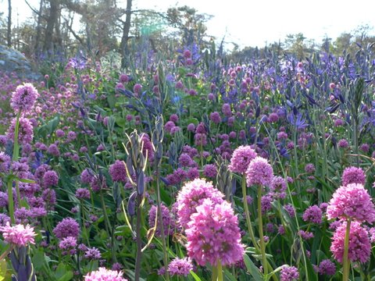


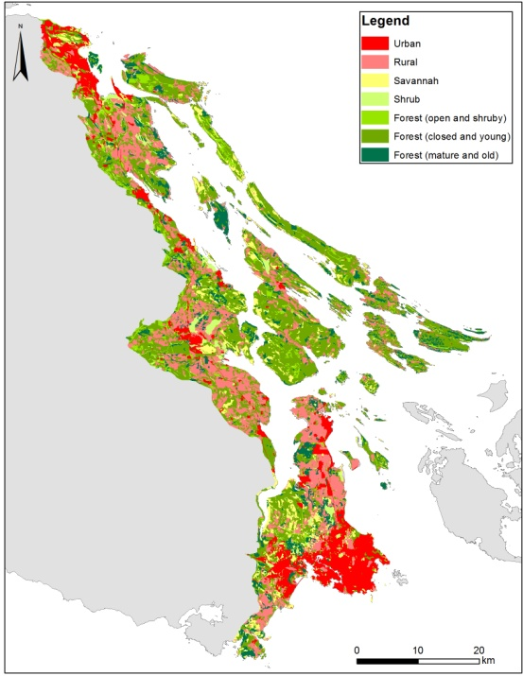
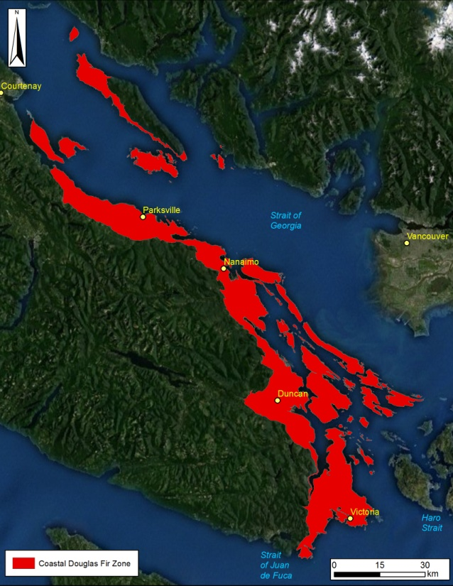
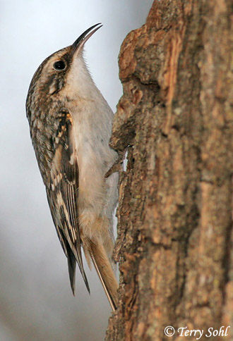
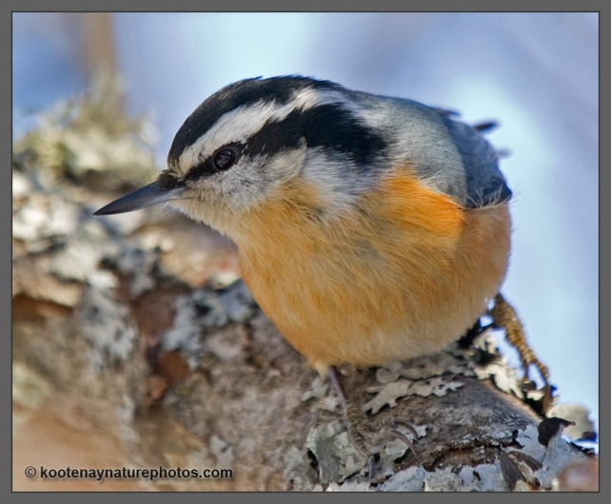
Conservation Prioritization: Introduction to the Coastal Douglas-fir
Richard Schuster
Liber Ero Fellow, Carleton University
Adjunct Prof, Ecosystem Science and Management Program, UNBC

Slide 2
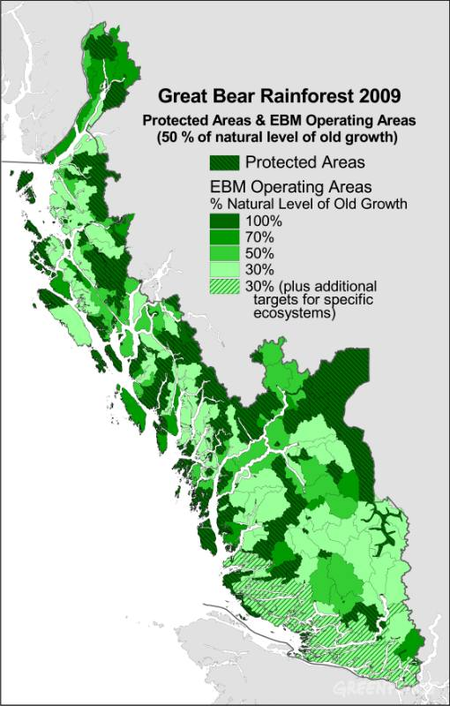
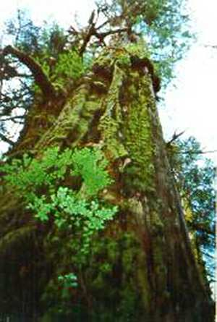
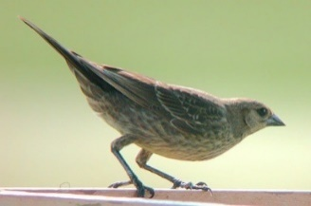
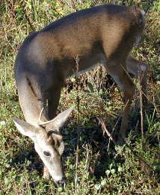
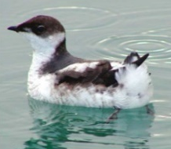
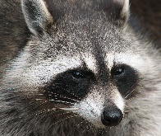
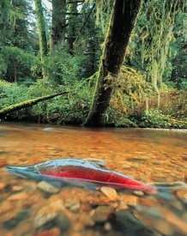
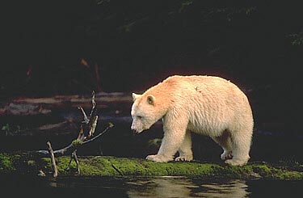
Traditional Goal of Conservation Area Design
Prioritize and Conserve ‘Intact’ or ‘Relic Ecosystems’
Multiple criteria
Decision support tools
Impractical in Human-dominated Landscapes
No Benchmark Ecosystems
Biological Survey Data Often Biased
Many Threats Hard to Map

Slide 3
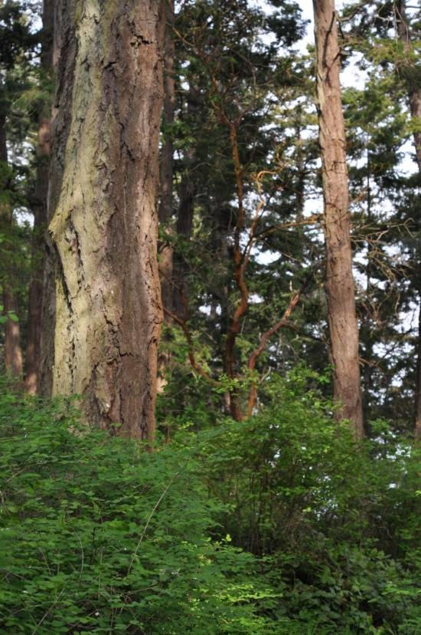
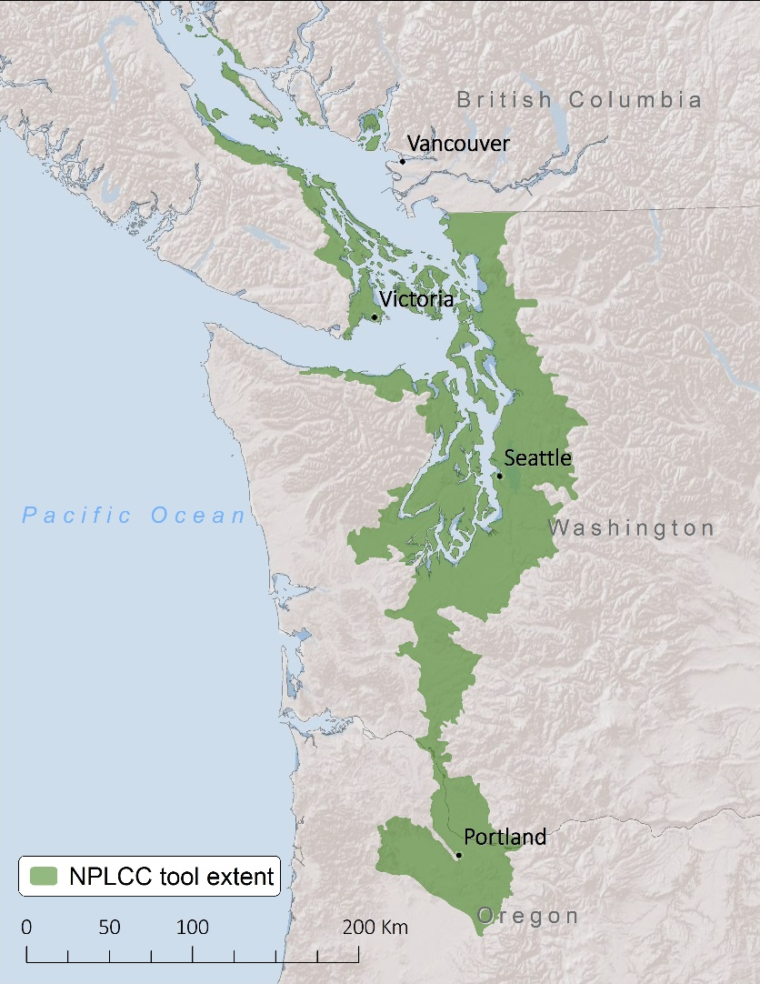
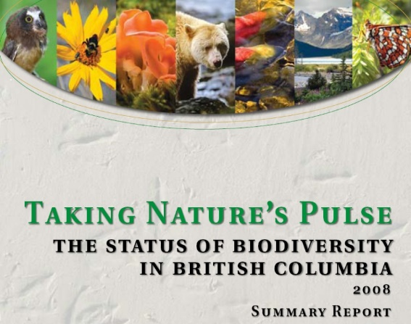
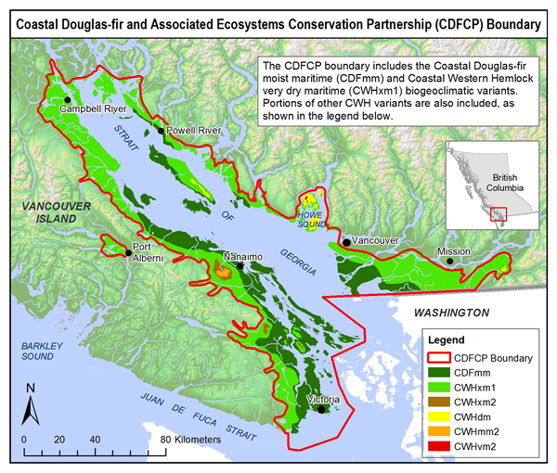
Dry Forest / Savanna Habitats of the Georgia Basin
49% Converted to Human Use
< 3% Pre-settlement Forest Intact
> 80% Privately-owned
>153 Species At Risk
Most Imperiled Ecosystem in BC
Vancouver
And Throughout the Pacific Northwest

Slide 4

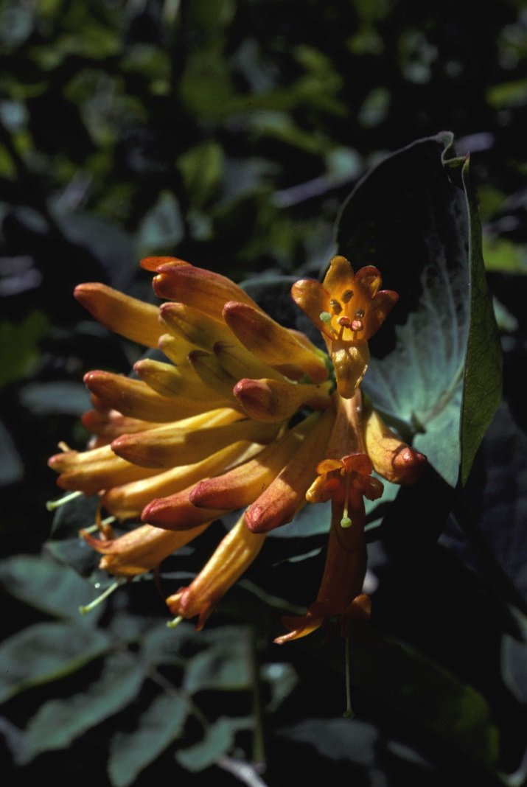
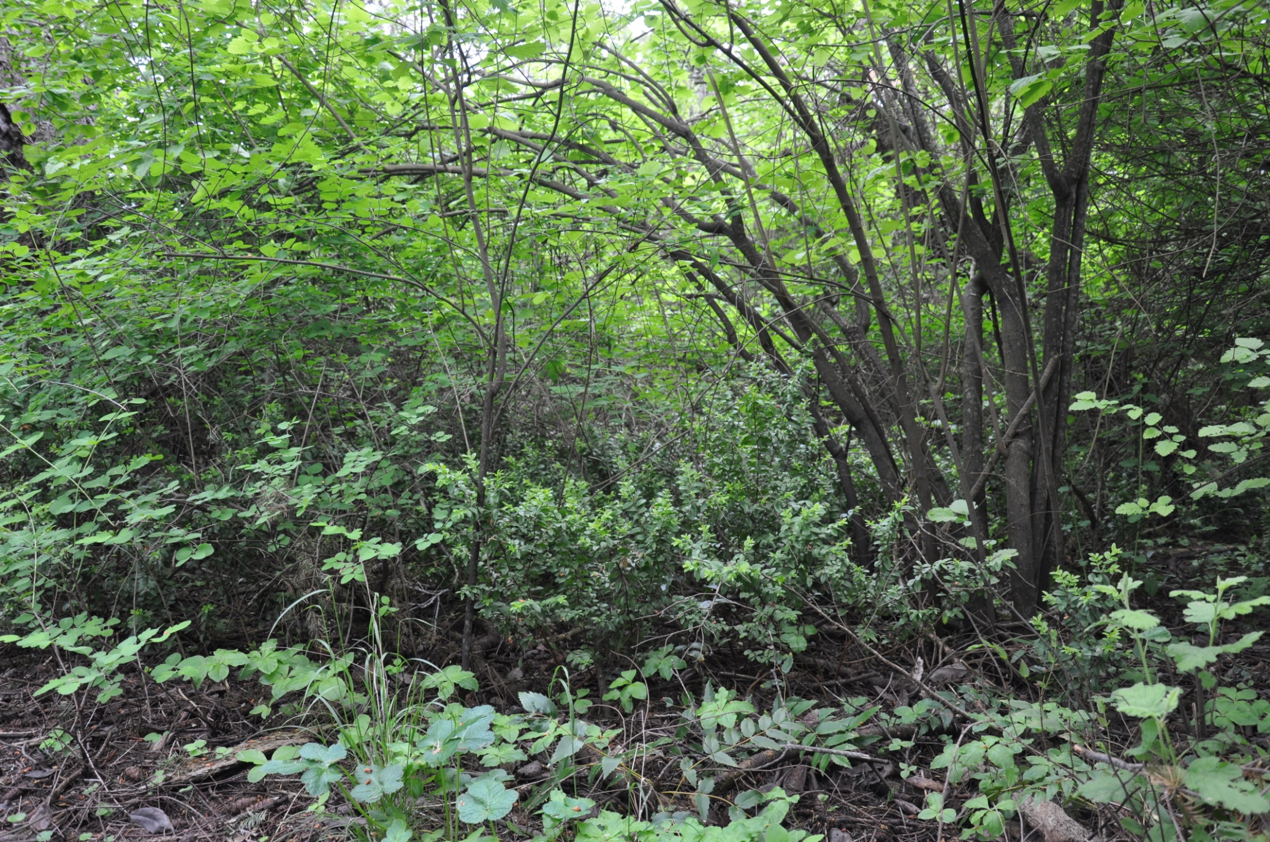
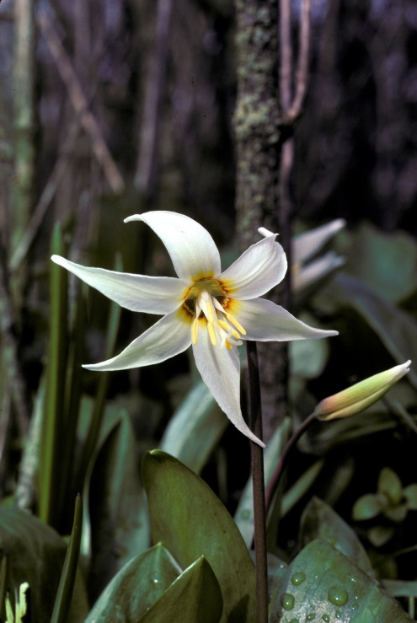
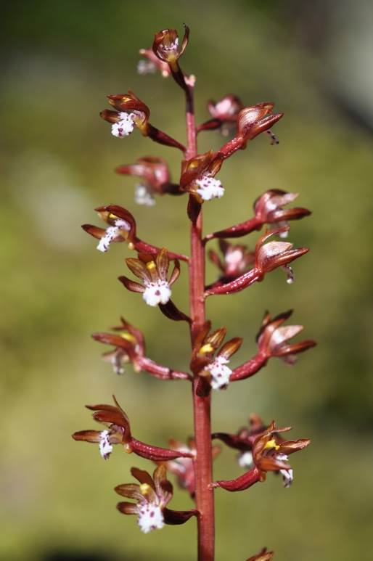
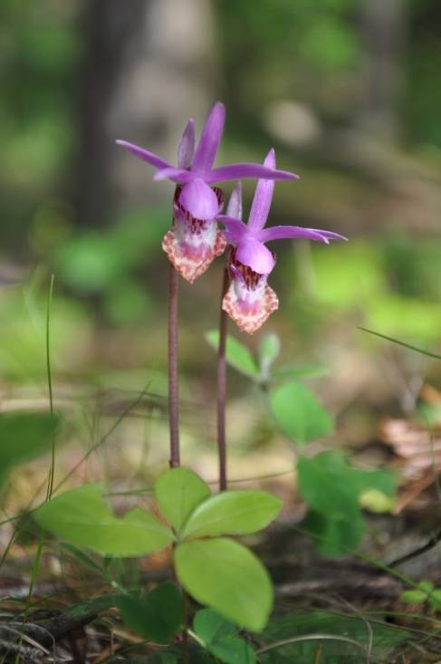
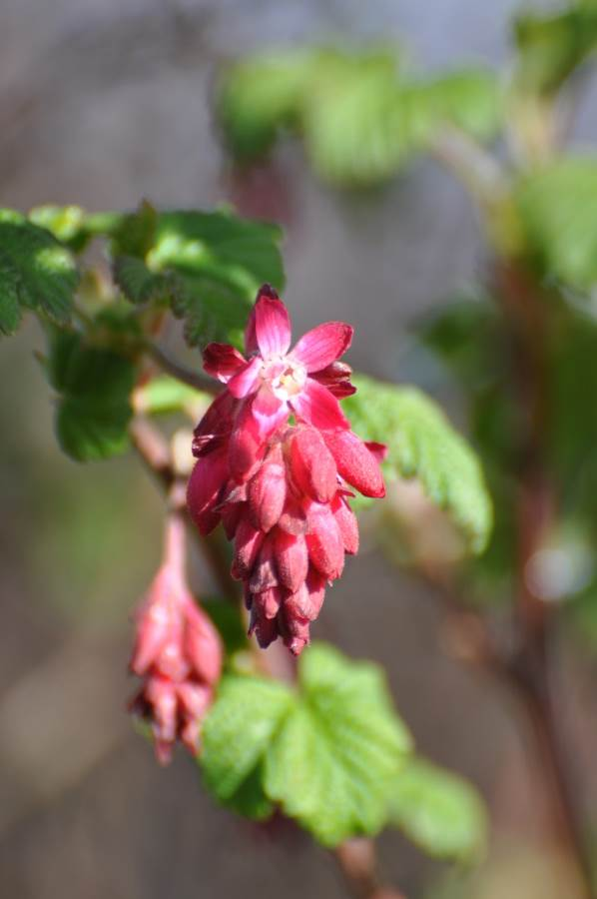
Forested Deep Soil Sites

Slide 5
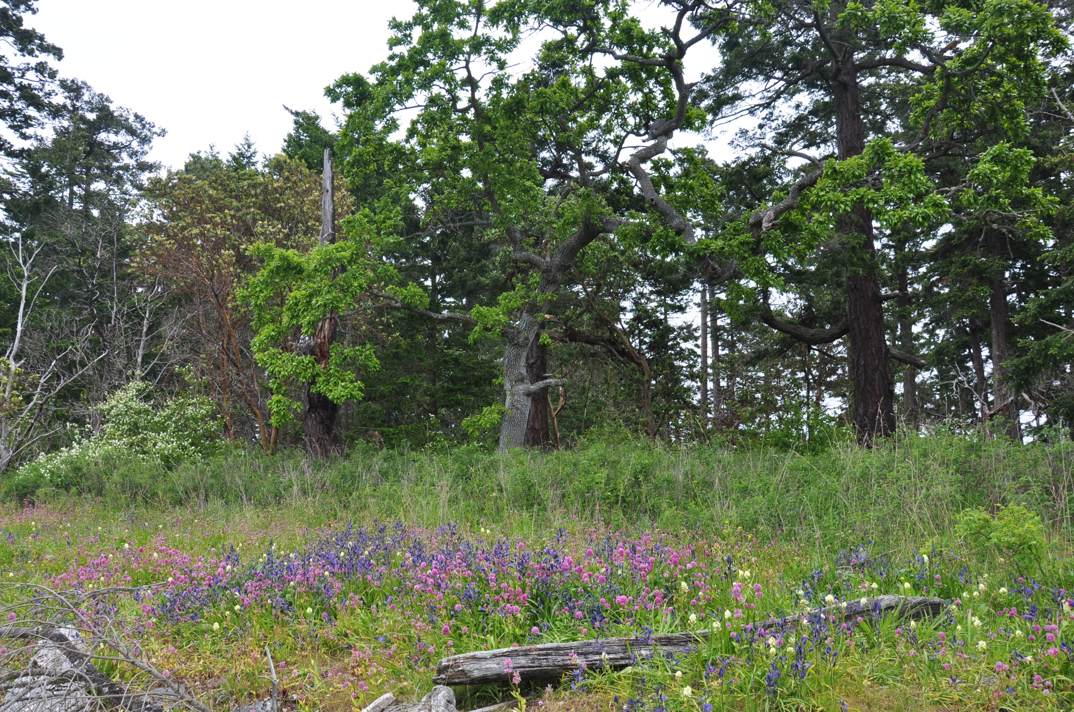
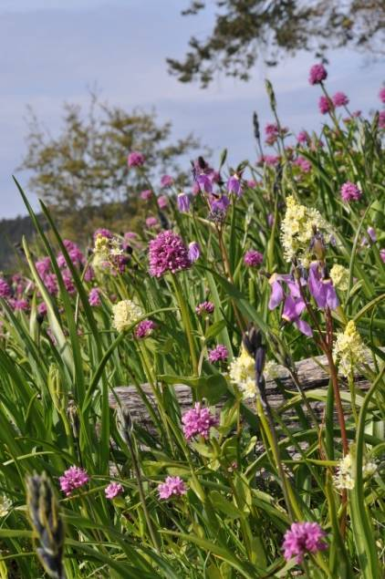
Shallow-soil `Garry Oak` Meadow and Woodland
High Alpha Diversity at Site Level
High Beta Diversity at Local Scales
High Gamma at Landscape Scales

Slide 6
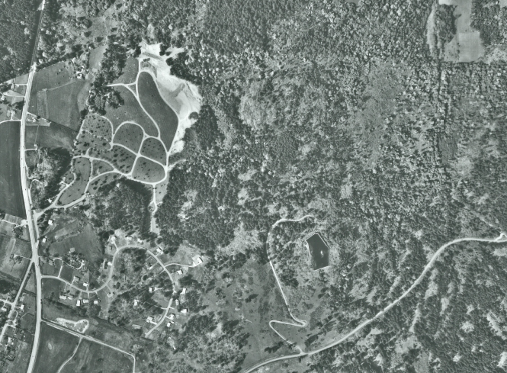
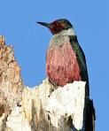
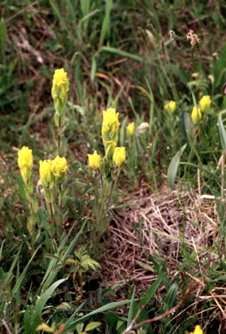
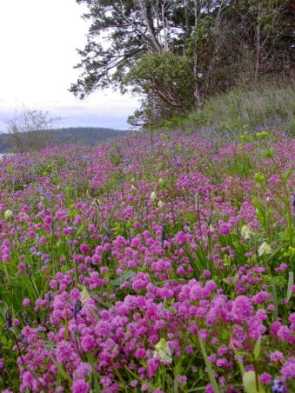
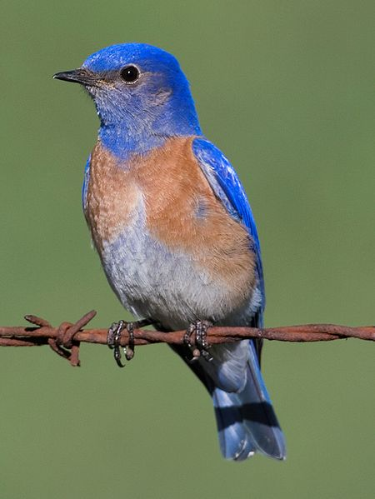
A Human Dominated Landscape
Lewis’s woodpecker
Golden Paintbrush
Royal Oaks, Victoria BC
Royal Oak 1964
Oak meadow
Key Concerns
Habitat loss/Fragmentation
Viability of Small Populations
Exotic Competitors/Predators
Over-abundant Species
Western bluebird

Slide 7
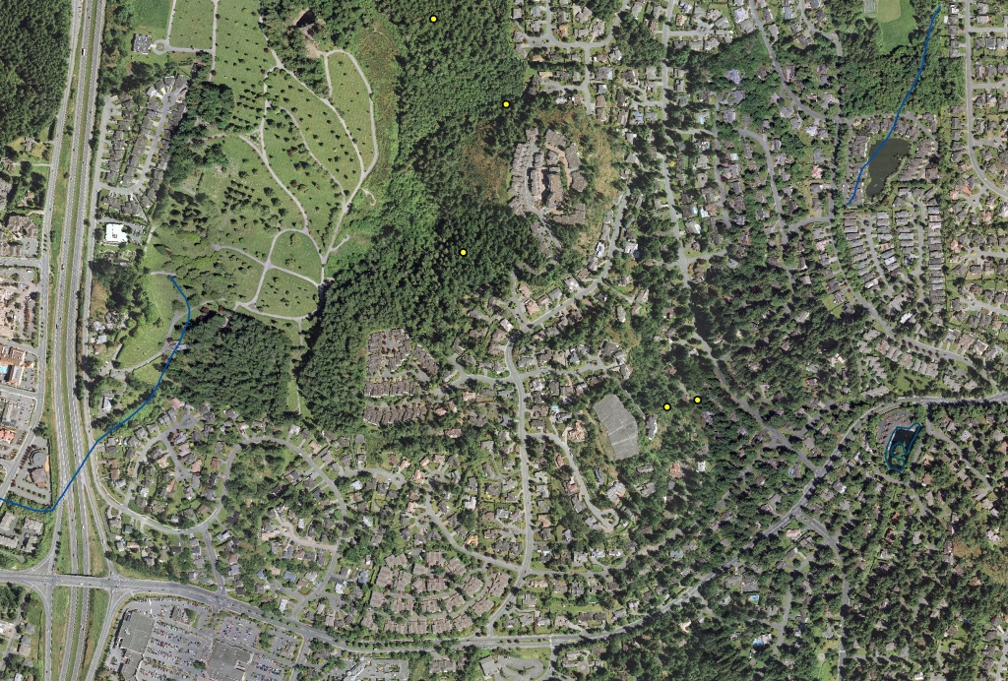
Habitat Loss and Fragmentation
Royal Oaks
Victoria, BC
1964 vs 2005
High Urgency, High Threat
Viability?

Slide 8
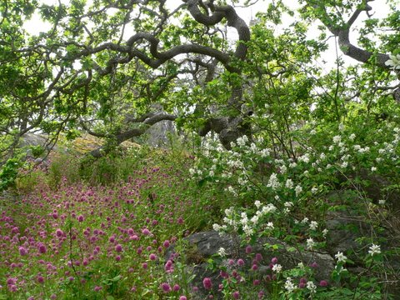

Indirect Effects of Humans Can Erode or Reverse those Patterns
Tom Rooney Re-surveyed 115 Mid-west
Plots Established in 1940
18% of species gone from plots
55% gone from plots in Parks
Lessons
Many Protected Areas are Not Maintaining Valued Species / Communities
Conserving Native Species Will Require Stewardship in Human-dominated Landscapes

Slide 9
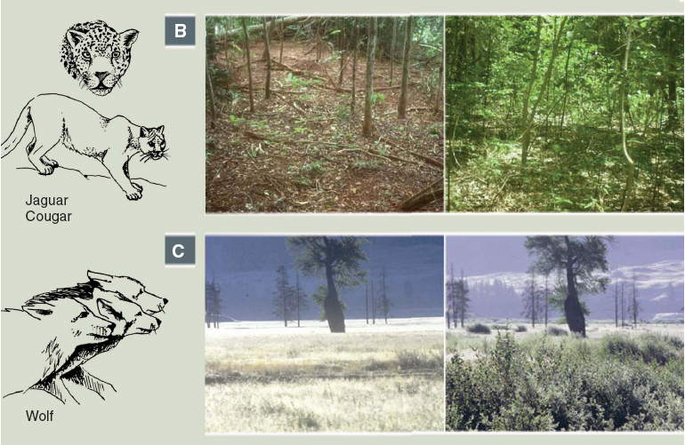
Trophic Downgrading of Planet Earth: Removal of ‘Apex’ Predators
Estes et al. 2011, Science

Slide 10
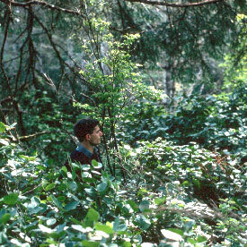
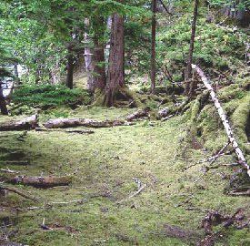
Human Settlers Introduced Species that Engineer Novel Plant and Animal Communities: Deer in Haida Gwaii
www.rgisbc.com

Slide 11
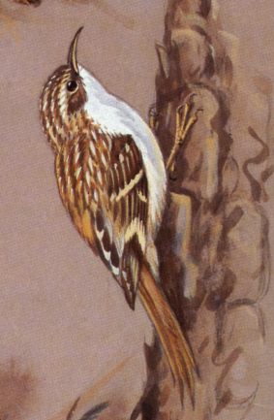
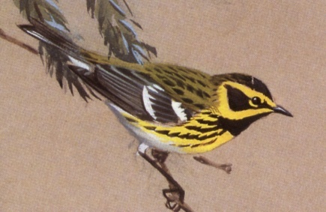
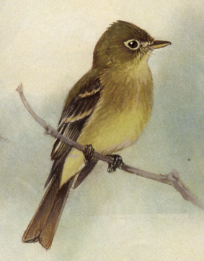
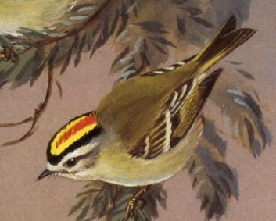
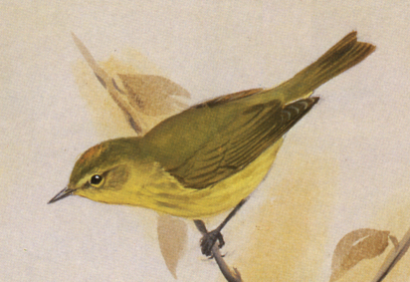
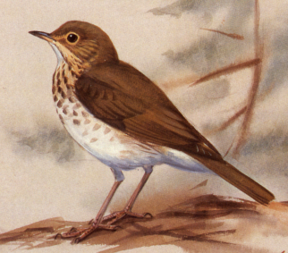
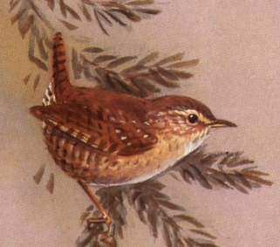
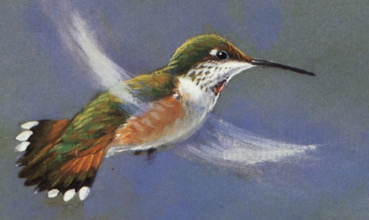
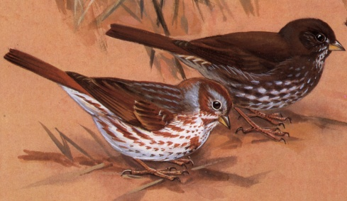
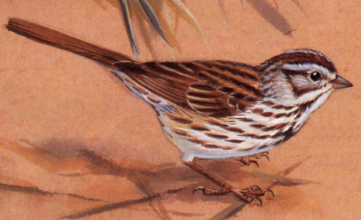
Carry-over to Bird Populations
Trees
Shrubs
Ground
Drawings J.A.Crosby

Slide 12
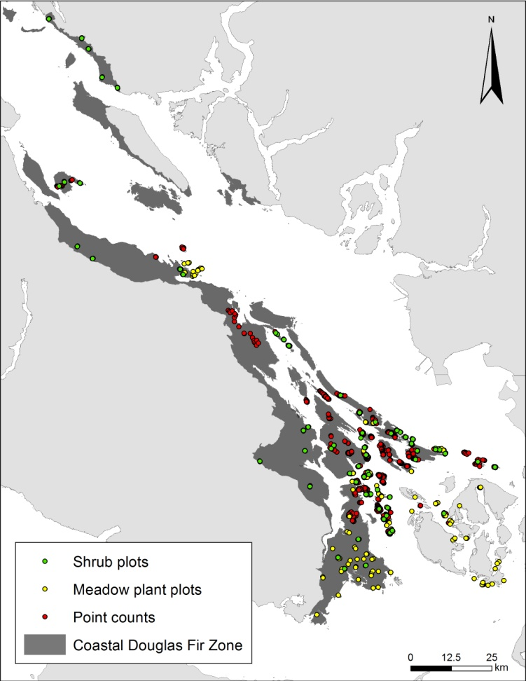
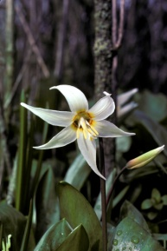
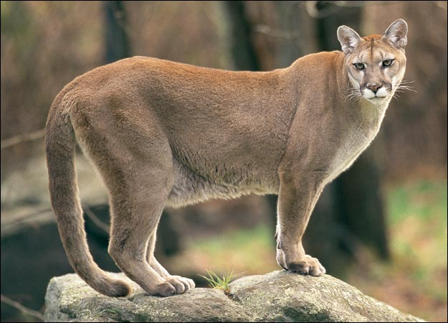
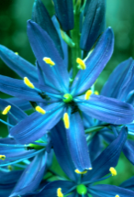
Deer in the Georgia Basin
- Historic Deer Densities Were Low due to Predation and Hunting
Deer Often Exceed 1/ha where Predators and Hunting are Absent
Animal Planet

Slide 13
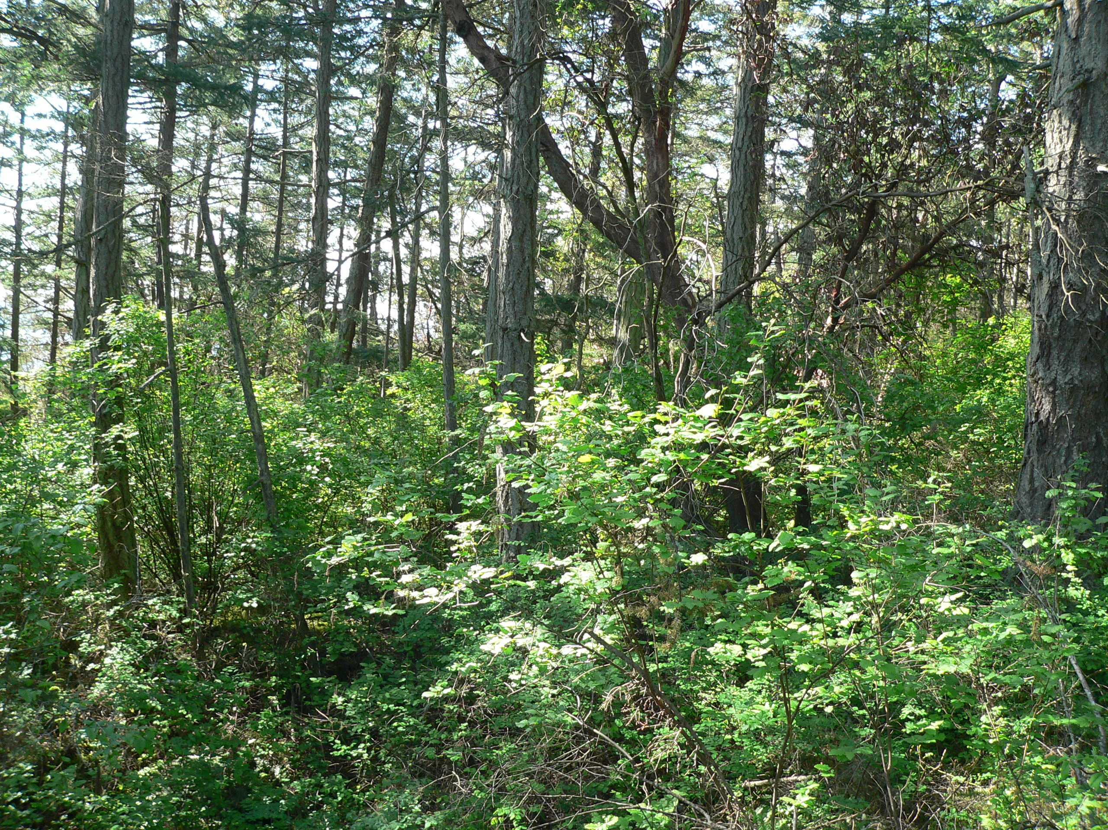


Slide 14


Slide 15


Slide 16




First Nations History
Camas gardens of the Coast Salish
400 bulbs/hr
36-40 kg/d
1.0 – 2.3 million bulbs/1000 people/yr
Turner 2014,
Beckwith 2004

Slide 17




Culturally Significant Food Plants
"The Importance of a Rose": Evaluating the Cultural Significance of Plants in Thompson and Lillooet Interior Salish.
Turner, N. Am. Anthropol. (1988)
CS = Quality + Intensity + Exclusivity of Use
Highly Ranked Species
Amalanchier alnifolia (CS = 134) 3L/hr
Rosa nutkana (CS = 92) 3L/hr
Rubus spp 1.5-3L/hr

Slide 18



Palatability and Shrub Species Diversity
A ‘Cafeteria’ Experiment
12 Focal Species
Palatable
Less Palatable

Slide 19

Palatability

Slide 20




Deer Drive Shrub Community Structure
Mean Shrub Cover (%)

Slide 21


Deer Reduce Community Complexity and Shrub Species Richness
Species Richness Native Cover (%)
Link Island
Ruxton Island

Slide 22




Gulf Island Birds Follow Haida Gwaii Trends
Strongly negative prediction
low
mod
high
Log abundance
All 10 predicted to decline strongly, did so
Martin et al. 2011
Notes:
22
Birds predicted to be strongly impacted by deer browsing based on foraging and nesting preferences.
Note – this is a Bayesian analysis – hence we don’t use p values.
To interpret significance.
Posterior coefficient = log abundance. Estimates which include zero line are not significantly different from zero. Estimates which are above the zero line show significant increase in abundance, whereas estimates below the zero line show significant decrease in abundance. E.g RUHU is significantly more abundance on islands with no deer (low), and significantly less abundant on islands with high amounts of deer.

